Slide 1

FACIAL EMOTION DETECTION USING CONVOLUTIONAL NEURAL NETWORKS BY COMPUTING IMAGE EDGES
DEPARTMENT OF COMPUTER SCIENCE AND ENGINEERING
Under the guidance of
Mr. V. Siva Prasad, M.Tech Assistant Professor, Department of CSE, Sree Vidyanikethan Engineering College, Tirupati
By
S HEMA (18121A05K8) S HEMANTH(18121A05K9) S MADHURI (18121A05L3) S RAKESH (18121A05L5)
S BHARATH REDDY(18121A05L6)

Slide 2
INDEX
Abstract
Introduction
Problem Statement
Objective
Hardware and Software Requirements
References

Slide 3
ABSTRACT
Human emotion recognition plays an important role in the interpersonal relationship. Emotion detection from image is one of the most powerful and challenging research task in social communication. The automatic recognition of emotions has been an active research topic from early eras. Therefore, there are several advances made in this field. Hence extracting and understanding of emotion has a high importance of the interaction between human and machine communication. When it comes to image processing, deep learning (DL)-based emotion recognition outperforms classical methods. This paper proposes a face expression identification approach based on a convolutional neural network (CNN) and image edge detection to avoid the complex process of explicit feature extraction in traditional facial expression recognition. The edge of each layer of the image is retrieved in the convolution process after the facial expression image is normalised. The maximum pooling method is then used to reduce the dimensionality of the extracted implicit features. Finally, a Softmax classifier is used to classify and recognise the expression of the test sample image.

Slide 4
INTRODUCTION
Emotion is a mental state associated with the nervous system associated with feelings, perceptions, behavioural reactions, and a degree of gratification or displeasure .
One of the current application of artificial intelligence (AI) using neural networks is the recognition of faces in images and videos for various applications.
This paper presents a method for identifying seven emotions such as anger, disgust, neutral, fear, happy, sad, and surprise using facial images. Previous research used deep-learning technology to create models of facial expressions based on emotions to identify emotions.
A rapid R-CNN (Faster Regions with Convolutional Neural Network Features) facial expression identification approach is presented to sidestep the complicated procedure of explicit feature extraction and low-level data manipulation in traditional facial expression detection.
The convolution core of FRR-CNN (A Feature Redundancy Reduced Convolutional Neural Network), unlike classic CNN, diverges due to greater discriminant differences between feature maps at the same level, resulting in less duplicated features and a more compact picture representation.
The maximum pooling method is utilized in this paper to reduce the dimension of the retrieved implicit features, which reduces the convolutional neural network model's training time.

Slide 5
PROBLEM STATEMENT
The problem statements in this model are having robust and automated face detection, analysis of the captured image and its meaningful analysis by facial expressions, creating data sets for test and training. A model design is proposed which is capable of recognizing up-to seven emotions which are considered universal among all walks of cultures. Mainly being anger, disgust, neutral, fear, happy, sad, and lastly surprise. The system should be able to understand a face and its characteristics and then make a weighted assumption of the facial emotions of a person.

Slide 6
OBJECTIVE
The proposed model uses the deep learning (DL) open library “Keras” provided by Google for facial emotion detection, by applying robust CNN to image recognition.
It detects expressions and image edges by means of an emotion model created by a CNN using deep learning.
Emotion detection is implemented using keras with the proposed network. The networks are program on top of keras, operating on Python, using the keras learn library.

Slide 7
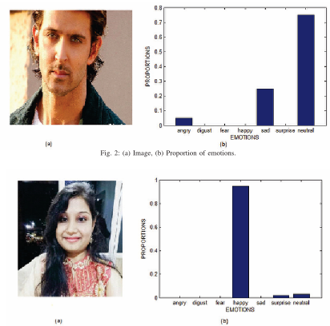
OBJECTIVE
Fig. 3: (a) Image, (b) Proportion of emotions.

Slide 8
HARDWARE SPECIFICATIONS:
Processor : I5/Intel Processor
RAM : 8GB (min)
Hard Disk : 128 GB
SOFTWARE SPECIFICATIONS:
Operating System : Windows 10
Server-side Script : Python 3.6
IDE : Jupyter notebook
Libraries Used : Numpy, IO, OS, Flask, keras, pandas,
FER(Face Emotion Recogniser)

Slide 9
REFERENCES
H. Zhang, A. Jolfaei and M. Alazab, "A Face Emotion Recognition Method Using Convolutional Neural Network and Image Edge Computing," in IEEE Access, vol. 7, pp. 159081-159089, 2019, doi: 10.1109/ACCESS.2019.2949741.
R. M. Mehmood, R. Du, and H. J. Lee, ‘‘Optimal feature selection and deep learning ensembles method for emotion recognition from human brain EEG sensors,’’ IEEE Access, vol. 5, pp. 14797–14806, 2017.
T. Song, W. Zheng, C. Lu, Y. Zong, X. Zhang, and Z. Cui, ‘‘MPED: A multi-modal physiological emotion database for discrete emotion recognition,’’ IEEE Access, vol. 7, pp. 12177–12191, 2019.

Slide 10
THANK YOU

